Slide 1
Outbound Integrations for API platform
aka communicating system events to affiliates

Slide 2
Scenario
Insurance provider wants to share customer events, with affiliate organisations. e.g. policy purchased, activated, refunded, etc.
This will enable multiple business scenarios like referral, white labelling, etc.

Slide 3
Options?
Polling
WebHooks
WebSub
WebTask

Slide 4


Polling
Insurer
Builds
and
Operates
Simple implementation
But,
Majority of poll requests are wasted
costly for insurer and affiliate to operate due to wasted calls
Insurer Core Business System
Insurer
API Platform
poll request
poll response
poll request
poll response
poll request
poll response
98.5% of
polls are wasted
Affiliate
System
Source
http://resthooks.org/

Slide 5

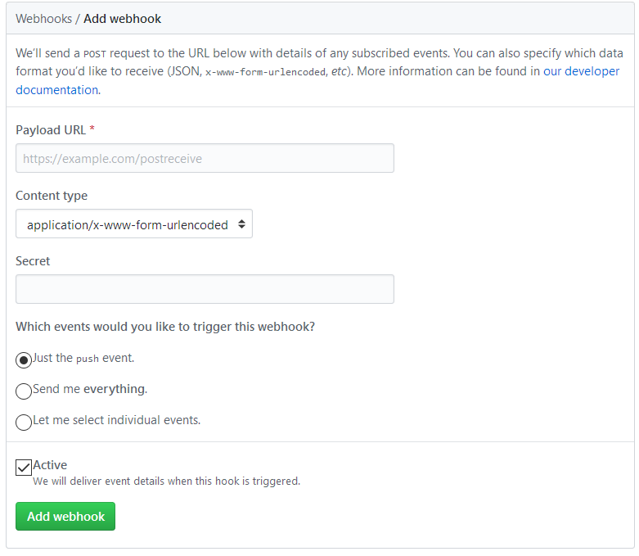
WebHooks, user-define HTTP call-backs
https://github.com/{...}/settings/hooks/new
better than polling
But,
costly for insurer to implement and operate (services, queues, protocol adaptors, etc.)
susceptible to DDOS (no subscription verification step)
Insurer
Builds
and
Operates
Insurer Core Business System
2 trigger webhook
Insurer
API Platform
Insurer WebHook Provider
1 subscribe
3 fire webhook
Affiliate Core
System
Affiliate
WebHook Consumer

Slide 6


WebSub, extension of WebHooks
Insurer
builds
and
operates
A HUB mediates between insurer and affiliate systems
Subscriptions are verified by hub by issuing a challenge to subscriber (affiliate) and expecting back a result with validation code
Events communicated in 2 modes
light ping – (3) insurer pushes event only, (5) affiliate subsequently pulls full data from insurer API
fat ping – (3) insurer pushes event with data
Insurer Core Business System
3 light/fat ping
Insurer
API Platform
Insurer
configures
and operates
5 optional
follow-up
API call
Insurer Hub
1
subscribe
2 verify
subscription
4 webhook fires
https://www.w3.org/TR/websub/
Affiliate Core
System
Affiliate
WebHook Consumer

Slide 7




WebTask, insurer hosts custom platform extension code provided by affiliates
Insurer
Builds
and
Operates
Insurer Core Business System
2 trigger webhook
This concept has been embraced by Auth0 for extending their platform
Insurer
API Platform
Insurer WebHook Provider
https://webtask.io/
Insurer
Hosts
and
Operates
Affiliate provided
custom code for extending insurer platform
https://auth0.com/
Code could be polling, webhook consumer, or anything else that affiliate requires
Affiliate Core
System

Slide 8
Event Notifications
Using Azure Event Grid and WebHooks

Slide 9
Abstract Flow
Subscriber
(Affiliate)
Publisher
(Insurer)
Hub
(Insurer)
1a - affiliate driven subscription
Subscriber discovers hub advertised by publisher’s topic
Subscriber makes a POST to hub to subscribe to updates about topic
Hub verifies subscription attempt via a POST, expects validation code to be echoed back
1b – insurer driven subscription
Subscription created on-behalf
of subscriber
2 – event notification
Publisher notifies hub of new content for the topic (events)
Hub delivers contents of topic (events with some payload) to subscriber, with links to get further details if required
3 – query (optional)
Subscriber queries updated data as indicated by event

Slide 10
WebSub-“like” implementation in Azure
Azure Event Grid with WebHook subscription – conforms to several aspects of the WebSub specification.
Discovery endpoint is a missing aspect. Required only for enabling subscriber driven subscription process (1a in protocol flow)

Slide 11

Demo Application (steps 1b and 2)
Created
Fulfilled
Partial
Refund
Refunded
Insurer HUB
route events to subscribers
Affiliate-A Webhook
Insurer
Client App
3- sub filter = “Affiliate-A”
/api/WebhookA
Topic – Become A Member
Event Type - Purchase.Created
POST /api/policy/
2 - push events
to hub topics
1 - drive policy lifecycle
/api/TransactionChanged
3- sub filter = “Affiliate-B”
Insurer API
Topic – Cancel My Membership
Event Type - Purchase.Refunded
Affiliate-B Webhook
light ping, follow-up query
GET /api/policy
4 query policy

